Slide 1
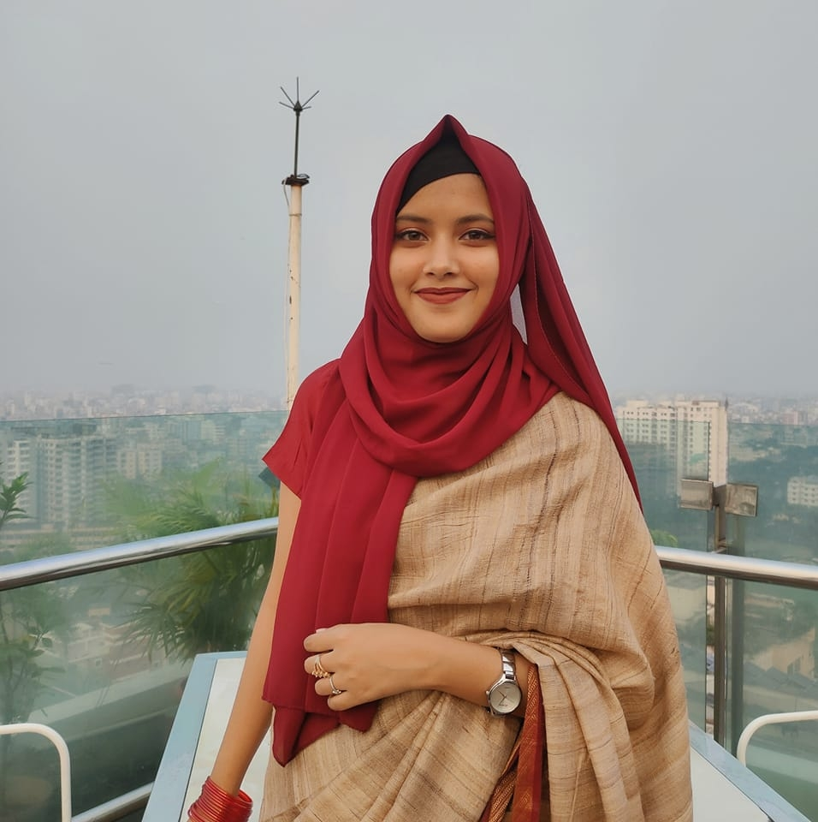
Sumiya Islam Barsha Student Email : sumiyabarsha992@gmail.com Rokeya Hall, Khulna University of Engineering & Technology,Khulna-9203
Education
BSc in Computer Science & Engineering , KUET(2020-2025)
HSC (2017-2019)
SSC (2007-2017)
Technical Skills
Language
C,C++,Java , Python,
Swift , Dart
Framework
Flutter
Web Programming
HTML5 ,C# ,CSS, Java Script, ASP. NET
DBMS
Oracle, Microsoft SQL Server, Firebase
Mobile App
Android, iOS
Links
https://www.linkedin.com/in/sumiya-barsha-a1462b2b1/
https://github.com/SumiyaBarsha
Language
English, Bengali
Objective:
I have a passion for software development and web development, and have experience building various projects as part of my undergraduate program. I am eager to apply my skills and knowledge to a professional setting as a Software Developer or Web Developer.
Projects:
ArtVenture : An e-commerce based android app for selling artworks.
MealBuddy : A flutter app for recommending meals for individual
Movie Ticketing System : A database project using Oracle Database
ArtVenture : An e-commerce based website built using ASP.NET
Cardiac Recorder : An android app for keeping track of heart rate on a regular basis
Experience :
Assistant Secretary of IT, KUET Bussiness and Enterprenuership Club(KBEC)
Reference:
Sunanda Das
Associate Professor,KUET
Email : sunanda@cse.kuet.ac.bd

